Slide 1
Predicting Movie Performance
William Lees IV (wjl2128)
Implementation of Machine learning and linear regression
12/17/2021

Slide 2
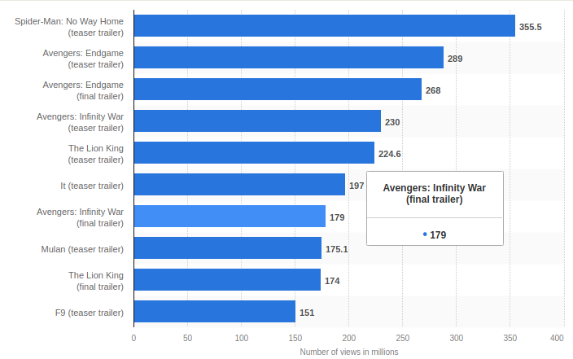
The Film Industry
The film is a 2.9 billion dollar industry
Each year there is roughly 300+ movies released to the general public.
Over 200 million box office tickets sold within 2021 alone.
Youtube Trailers have become one of the largest marketing stradigies
https://www.statista.com/statistics/554148/movie-teaser-trailer-view/
12/17/2021
William Lees IV (wjl2128)

Slide 3

Relevence Sonic Movie
April 4th 2020 First trailer for the sonic movie was released
The original design (left) was considered a citical disaster in character design
Based off feedback from social media sources the entire design was changed (Right)
This change cost the studio 35 Million Dollars to fix
Resulted in major setbacks to release date
The change as a result to the youtube and social media comments ended up revinued 154 million in box office sales.
12/17/2021
William Lees IV (wjl2128)

Slide 4
Goals
Can marketing a movie tailer still produce adequate profit even if the movie is viewed as overall bad in the public eye after release?
Are there any outliers?
Is it possible to predict the outcome of a movies performance (Rotten Tomato rating and net profit) based off twitter reviews of the trailer.
If it is possible to predict these things how will it impact the entertainment industry?
How will trailers adapt how will movies adapt to meet consumer needs when ML is implemented?
12/17/2021
William Lees IV (wjl2128)

Slide 5
Methods Used
Youtube API
Needed two keys to pull all data for 154 movie trailer links
Pandas
Used to manipulate and append CSV data
Urllib, Beautiful Soup
HTML Parsing for movie ranking (Rotten tomato ranks)
Selenium:google chrome
Useful google chrome python library to pull youtube java script data (comments)
Pyspark Linear Regression ML libraries
Dual linear regression models for movie ranking and net revinue
VectorizerAssembler
12/17/2021
William Lees IV (wjl2128)

Slide 6
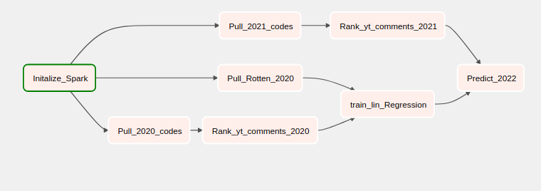
Linear regression process
Data Aquisistion
Youtube Codes: Uses Youtube API to pull trailer end code for youtube video. (2021 and 2022)
Youtube Comments: Uses Selenium libraries and youtube codes to pull trailer comment metadata
Tradeoff: Ammount of data for training VS Code run time (154 movies for 2021 alone)
Rotten Tomatos: Uses Html and Beautiful soup to scrape metadata for list of 2021 rotten tomato ranks
Data Processing
Comment ranking: Uses list of 2000+ common words with ranking (-5 to 5) to determine comment relevence
Linear Regression
Model 1 training: Uses pyspark ML Libraries to predict rotten tomato rating based off a comment ranking array
Model 2 training: Uses pyspark ML Libraries to predict Gross revenue based off rotten tomato, and comment ranking arrays
2022 Movie Data: Uses both trained models to predict outcomes for movies in 2022
12/17/2021
William Lees IV (wjl2128)

Slide 7
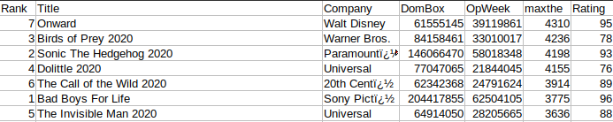
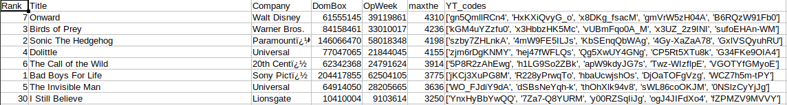
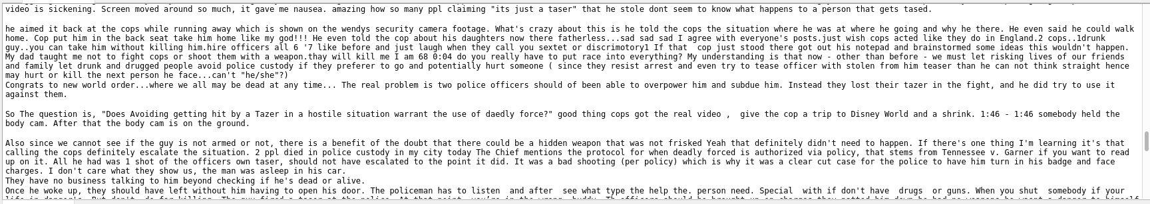
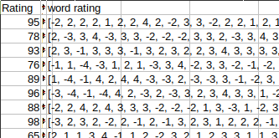
CSV Results
movies2020_ratings.csv
movies2020_codes.csv
Comments for first video
12/17/2021
William Lees IV (wjl2128)

Slide 8
Linear Regression Model Results
movies2020_ratings.csv
movies2020_codes.csv
Comments for first video
12/17/2021
William Lees IV (wjl2128)

Slide 9
Training/Test Data comparisons
Testing Dual linear regression models
70% learning data
30% test data
If linear regression provides poor results other ML models will be considered
Full evaluation of accuracy models will be evaluated if needed
Youtube API issues
One of the major setbacks to robust code is the limitiations to the youtube API
Work Arounds
HTML parsing and Js scraping both provide robust solutions to data cap limits
Future vidsual analysis
Data will be crossreference
Keyword corolation analysis will be performed
12/17/2021
William Lees IV (wjl2128)

Slide 10
Training/
Testing Dual linear regression models
70% learning data
30% test data
If linear regression provides poor results other ML models will be considered
Full evaluation of accuracy models will be evaluated if needed
Youtube API issues
One of the major setbacks to robust code is the limitiations to the youtube API
Work Arounds
HTML parsing and Js scraping both provide robust solutions to data cap limits
Future vidsual analysis
Data will be crossreference
Keyword corolation analysis will be performed
12/17/2021
William Lees IV (wjl2128)

Slide 11
Schedule
Task | Estimated Date Completion
Establish TCP connection to Twitter API | 11/12/2021
Pull IMDb data and append it to movie dataset | 11/12/2021
2020 Data formatting and Twitter ranking | 11/19/2021
Training Linear regression models | 11/22/2021
2022 Data formatting and Twitter ranking | 11/22/2021
Run Linear regression tests | 11/26/2021
Data analysis and visualization | 12/10/2021
Cross correlation data analysis | TBD: If time permits
12/17/2021
William Lees IV (wjl2128)

